Slide 1
Section 7.2 Graphing Linear Functions with Slopes

Slide 2
What is a “SLOPE”?
The slope of a line refers to how “steep” the line is
Lines with a larger slope is more steep that a line with less slope
the slope of a line does not depend on the length of the line
Which slope is greater? A or C? A or B? B or D?
Slope A
Slope B
Slope C
Slope D

Slide 3
Equation for the Slope:
The slope of a line can be determined by the change in height over the change in width
If we are given the coordinates of the endpoints as: (x₁,y₁) and (x₂,y₂)
To find the rise, subtract the y-coordinates
To find the run, subtract the x-coordinates

Slide 4

Ex: Given each of the line segments, find the slope:
Slope A
Slope C
Slope B

Slide 5
Ex#) Given the pair of coordinates, find the slope:
(5,2) & (–6,4)
b) (11, –5) & (7,–4)
c) (–5,3) & (–5, –4)

Slide 6
Special Slopes:
Slopes of Horizontal Lines:
Horizontal lines have a slope of Zero
because they do not have any Rise
Slopes of Vertical Lines:
Vertical lines have a slope that is “undefined” because
they have a Run of zero. Since you cannot divide by zero, the slope becomes undefined.

Slide 7
Positive and Negative Slopes:
Lines with Positive Slopes:
Lines with positive slopes point “upward”
Lines with Negative Slopes:
Lines with negative slopes point “downward”

Slide 8
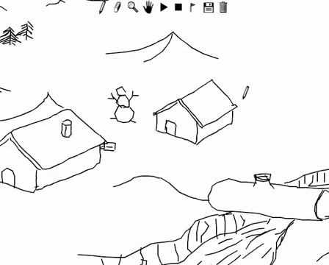
LINE RIDER

Slide 9
Finding Slope from a Line Equation:
To find the slope from an equation in the form of y =mx+b , isolate the “y” variable first
the value “m” multiplied to “x” is the slope
The slope will tell you how fast “y” is increasing/decreasing for every increment of “x”
Cost of a Taxi ride:
Slope =
2.25
How much you pay each hour
Salary at work:
Slope =
8.50
How much you earn each hour (hourly wage)
How far you’ve travelled:
Slope =
60
How many km you travel each hour (speed)

Slide 10
Ex: Find the slope for each equation

Slide 11
II) Graphing a Line with the Slope
Besides making a TOV, another way to graph a line is by finding a point on the Line, and then “apply” the slope to find other points
Ex: Graph a Line with slope 2/3 and crosses the point (1,2)
Start at the point that you’re given: (1,2)
Then apply the slope to find other points:
Connect the dots

Slide 12
Practice: Graph a Line with slope -3/2 and crosses the point (-2,-3)
Start at the point that you’re given: (-2,-3)
Then apply the slope to find other points:
Connect the dots

Slide 13
III) Constant Slope Property
Given the following line, find the slope of each line segment:
According to the “Constant Slope Property”, any two points on a line will always generate the same slope

Slide 14
Challenge Problem:
Given the following three points, check if whether if they are Collinear: A(4,3) , B(1,-1), C(-5,-9)
Constant Slope Property: Any points on the same line will generate the SAME slope
Graph the points
If the slope of the first two points is equal to the slope of the last two point, then the points are COLLINEAR!
Slopes are the same, so the points are COLLINEAR!

Slide 15
Challenge Problem: One endpoint of a line segment is A(- 4,6) and the other endpoint “B” is on the x-axis. If the slope is -3, find the coordinates of “B”.
A
(-4,6)

Slide 16
Challenge Problem:
Given that the following points are Collinear, find the value of “k”
Since the points are collinear, the slopes of AB and BC must be equal

Slide 17
Challenge Problem: One endpoint of a line segment is A(- 4,6) and the other endpoint “B” is on the x-axis. If the slope is -2, find the coordinates of “B”.
Plug the coordinates in your formula:
A(-4,6) B(k,0)
Simplify!
The coordinates of B will be (-1,0)

